Slide 1
Address Resolution Protocol (ARP)
TCP/IP Protocol Suite
Copyright © The McGraw-Hill Companies, Inc. Permission required for reproduction or display.

Slide 2
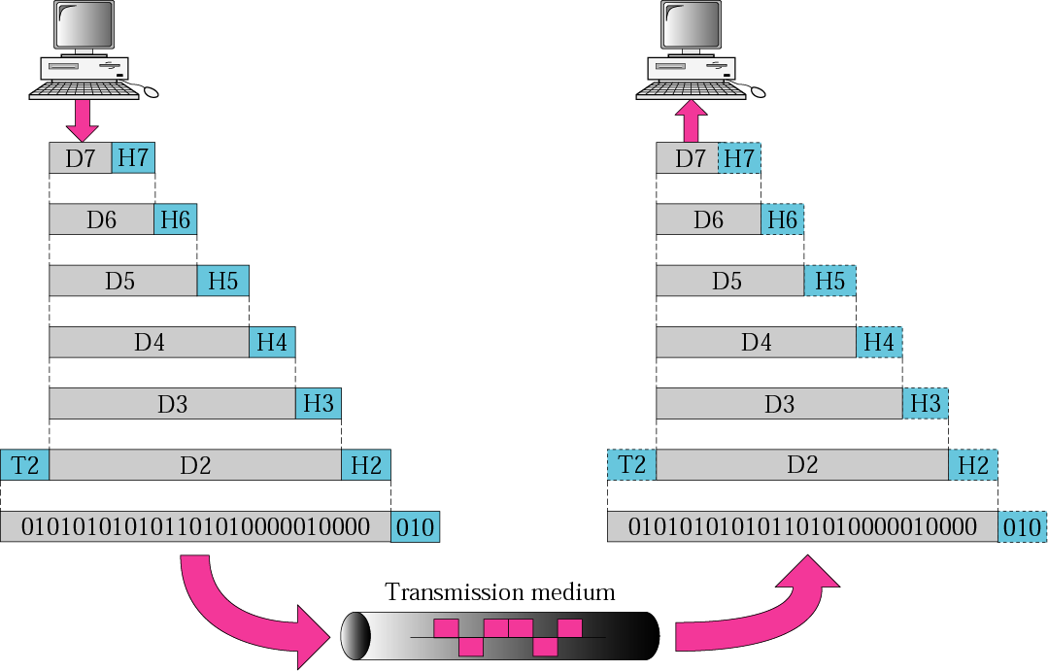
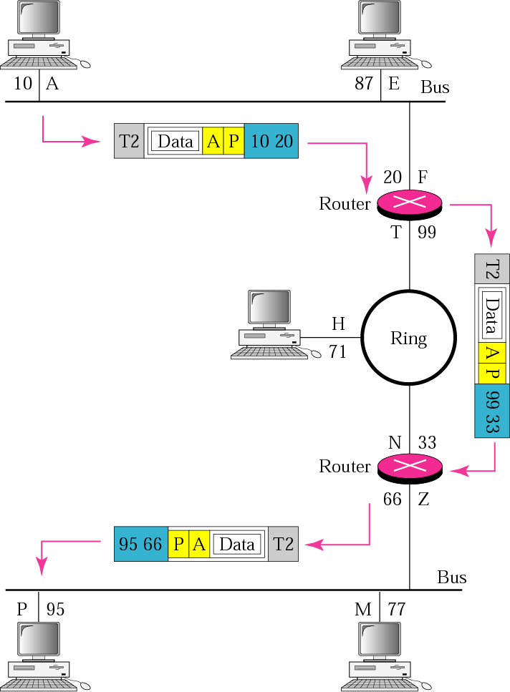
IP address : A, P
MAC address : 10, 95
TCP/IP Protocol Suite

Slide 3
8-1 ADDRESS MAPPING
Hosts and routers are recognized at the network level by their logical addresses.
It is called a logical address because it is usually implemented in software.
At the physical level, hosts and routers are recognized by their physical addresses.
A physical address is a local address. It should be unique locally, but not necessarily universally.
It is called a physical address because it is usually (but not always) implemented in hardware.
Examples of physical addresses are 48-bit MAC addresses in the Ethernet protocol, which are imprinted on the NIC installed in the host or router.
TCP/IP Protocol Suite

Slide 4
8-1 ADDRESS MAPPING
Delivery of a packet to a host or a router requires two levels of addressing: logical and physical.
Need to map a logical address to its corresponding physical address and vice versa.
These can be done using either static or dynamic mapping.
TCP/IP Protocol Suite

Slide 5
Static Mapping
Creating a table that associates a logical address with a physical address.
This has some limitations because physical addresses may change.
A machine could change its network interface card (NIC), resulting in a new physical address.
In some LANs, such as Local Talk, the physical address changes every time the computer is turned on.
To implement these changes, a static mapping table must be updated periodically.
TCP/IP Protocol Suite

Slide 6
Dynamic Mapping
Each time a machine knows the logical address of another machine, it can use a protocol to find the physical address.
Two protocols have been designed to perform dynamic mapping:
  Address Resolution Protocol (ARP)
  Reverse Address Resolution Protocol (RARP).
ARP maps a logical address to a physical address.
RARP maps a physical address to a logical address.
RARP is replaced with another protocol and therefore deprecated.
TCP/IP Protocol Suite

Slide 7
8-2 ADDRESS MAPPING
Anytime a host or a router has an IP datagram to send to another host or router, it has the logical (IP) address of the receiver.
But the IP datagram must be encapsulated in a frame to be able to pass through the physical network.
This means that the sender needs the physical address of the receiver.
ARP accepts a logical address from the IP protocol, maps the address to the corresponding physical address and pass it to the data link layer.
TCP/IP Protocol Suite

Slide 8
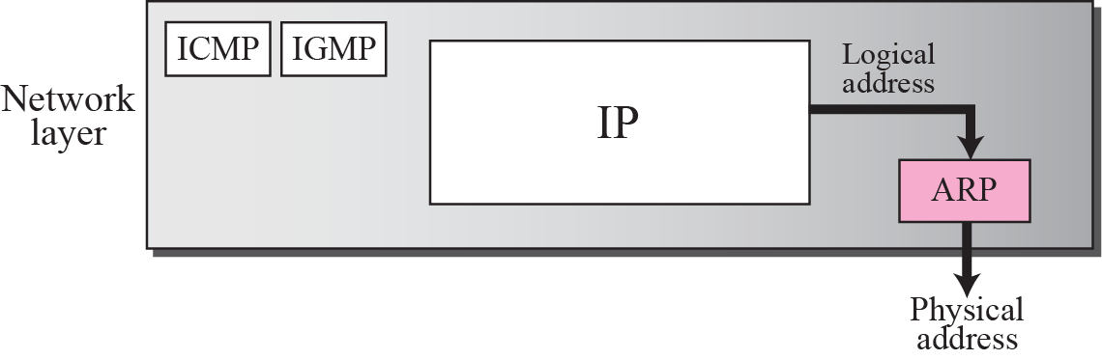
Figure 8.1 Position of ARP in TCP/IP protocol suite
TCP/IP Protocol Suite

Slide 9
Figure 8.1 Position of ARP in TCP/IP protocol suite
Anytime a host, or a router, needs to find the physical address of another host or router on its network, it sends an ARP query packet.
The packet includes the physical and IP addresses of the sender and the IP address of the receiver.
Because the sender does not know the physical address of the receiver, the query is broadcast over the network.
TCP/IP Protocol Suite

Slide 10
Figure 8.1 Position of ARP in TCP/IP protocol suite
Every host or router on the network receives and processes the ARP query packet, but only the intended recipient recognizes its IP address and sends back an ARP response packet.
The response packet contains the recipient’s IP and physical addresses.
The packet is unicast directly to the inquirer using the physical address received in the query packet.
TCP/IP Protocol Suite

Slide 11
Figure 8.1 Position of ARP in TCP/IP protocol suite
The system on the (A) has a packet that needs to be delivered to another system (B) with IP address 141.23.56.23.
System A needs to pass the packet to its data link layer for the actual delivery, but it does not know the physical address of the recipient.
It uses the services of ARP by asking the ARP protocol to send a broadcast ARP request packet to ask for the physical address of a system with an IP address of 141.23.56.23.
This packet is received by every system on the physical network, but only system B will answer it.
System B sends an ARP reply packet that includes its physical address.
Now system A can send all the packets it has for this destination using the physical address it received.
TCP/IP Protocol Suite

Slide 12
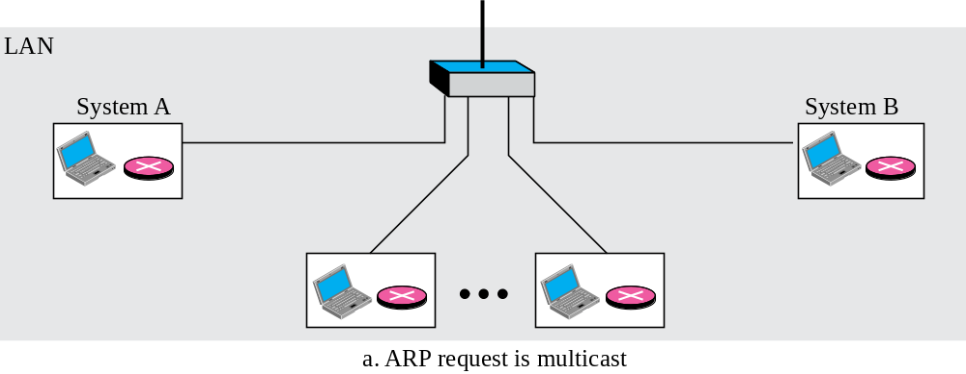
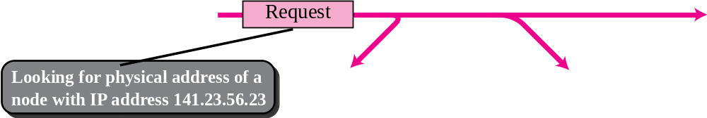
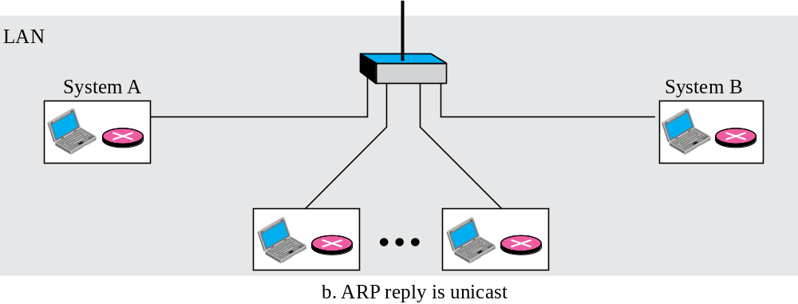
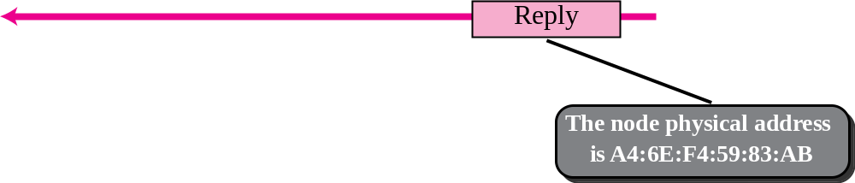
Figure 8.2 ARP operation
broadcast
TCP/IP Protocol Suite

Slide 13
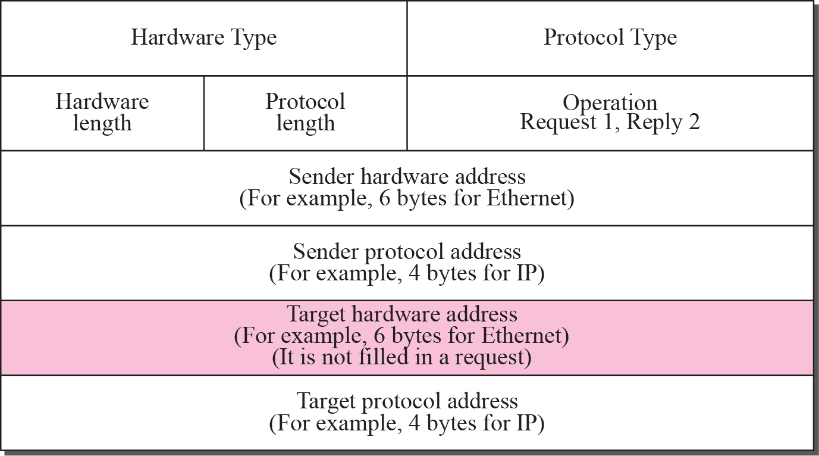
Figure 8.3 ARP packet
Packet Format
Hardware type. 16-bit field defining the type of network on which ARP is running. For Ethernet type is 1.
Protocol type. 16-bit field defining the protocol. For example, the value of this field for the IPv4 protocol is 0800₁₆. ARP can be used with any higher-level protocol.
Hardware length. 8-bit field defining the length of the physical address in bytes. For Ethernet, value is 6.
Protocol length. 8-bit field defining the length of the logical address in bytes. For the IPv4 value is 4.
TCP/IP Protocol Suite

Slide 14
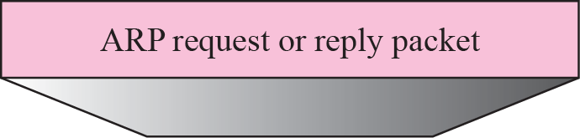
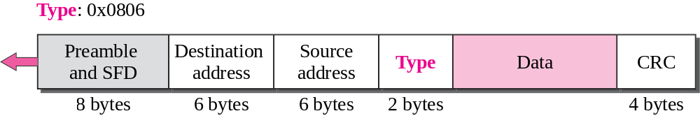
Figure 8.4 Encapsulation of ARP packet
Encapsulation
An ARP packet is encapsulated directly into a data link frame.
Example shows ARP packet encapsulated in an Ethernet frame.
Type field indicates that the data carried by the frame is an ARP packet.
TCP/IP Protocol Suite

Slide 15
Operation
ARP functions on a typical internet.
steps involved.
Four cases in which a host or router needs to use ARP.
TCP/IP Protocol Suite

Slide 16
7 Steps Involved in an ARP Process
1. The sender knows the IP address of the target.
2. IP asks ARP to create an ARP request message, filling in the sender physical address, the sender IP address, and the target IP address. The target physical address field is filled with 0s.
3. The message is passed to the data link layer where it is encapsulated in a frame using the physical address of the sender as the source address and the physical broadcast address as the destination address.
4. Every host or router receives the frame. Because the frame contains a broadcast destination address, all stations remove the message and pass it to ARP. All machines except the one targeted drop the packet. The target machine recognizes the IP address.
5. The target machine replies with an ARP reply message that contains its physical address. The message is unicast.
6. Sender receives the reply message. Which contains the physical address of the target machine.
7. The IP datagram, which carries data for the target machine, is now encapsulated in a frame and is unicast to the destination.
TCP/IP Protocol Suite

Slide 17

Note
An ARP request is broadcast;
an ARP reply is unicast.
TCP/IP Protocol Suite

Slide 18
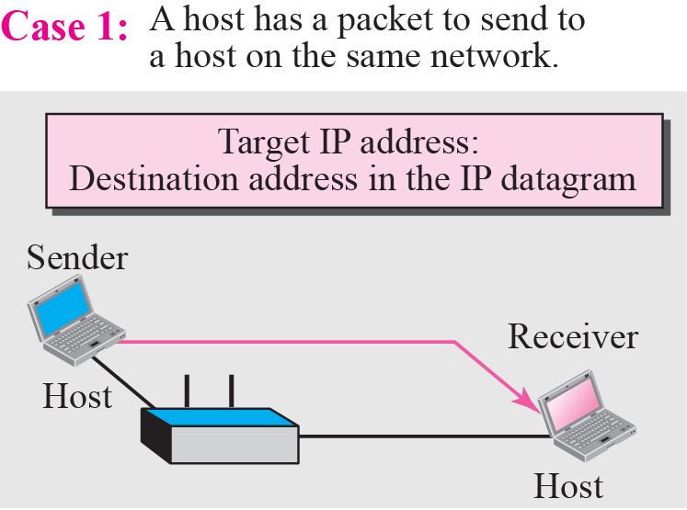
Figure 8.5 Four cases using ARP
Four Different Cases
Four different cases in which the services of ARP can be used.
Case 1:
Sender is a host and wants to send a packet to another host on the same network.
In this case, the logical address that must be mapped to a physical address is the destination IP address in the datagram header.
TCP/IP Protocol Suite

Slide 19
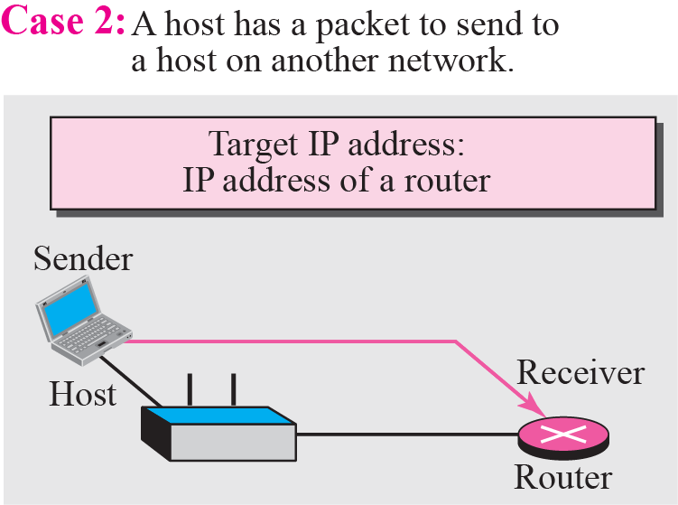
Figure 8.5 Four cases using ARP
Case 2:
Sender is a host and wants to send a packet to another host on another network.
In this case, the host looks at its routing table and finds the IP address of the next hop (router) for this destination. If it does not have a routing table, it looks for the IP address of the default router. The IP address of the router becomes the logical address that must be mapped to a physical address
TCP/IP Protocol Suite

Slide 20
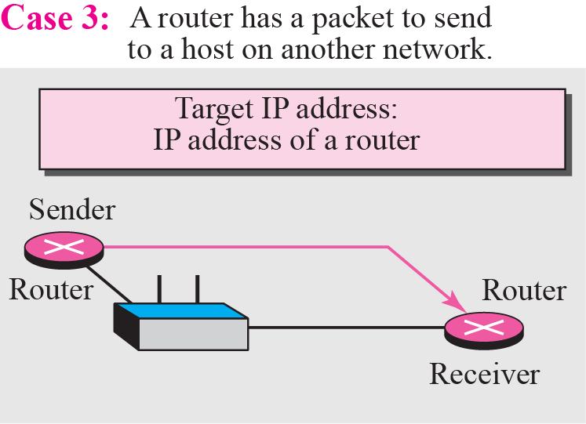
Figure 8.5 Four cases using ARP
Case 3:
Sender is a router that has received a datagram destined for a host on another network.
It checks its routing table and finds the IP address of the next router. The IP address of the next router becomes the logical address that must be mapped to a physical address.
TCP/IP Protocol Suite

Slide 21
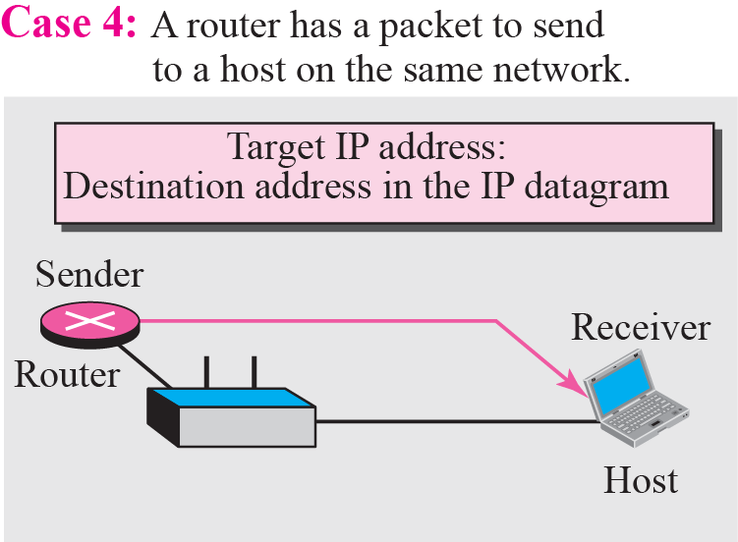
Figure 8.5 Four cases using ARP
Case 4:
Sender is a router that has received a datagram destined for a host in the same network.
Destination IP address of the datagram becomes the logical address that must be mapped to a physical address.
TCP/IP Protocol Suite

Slide 22
Example 8.1
A host with IP address 130.23.43.20 and physical address B2:34:55:10:22:10 has a packet to send to another host with IP address 130.23.43.25 and physical address A4:6E:F4:59:83:AB.
The two hosts are on the same Ethernet network.
Show the ARP request and reply packets encapsulated in Ethernet frames.
Hardware type: 0x0001
Protocol type: 0x0800
TCP/IP Protocol Suite

Slide 23
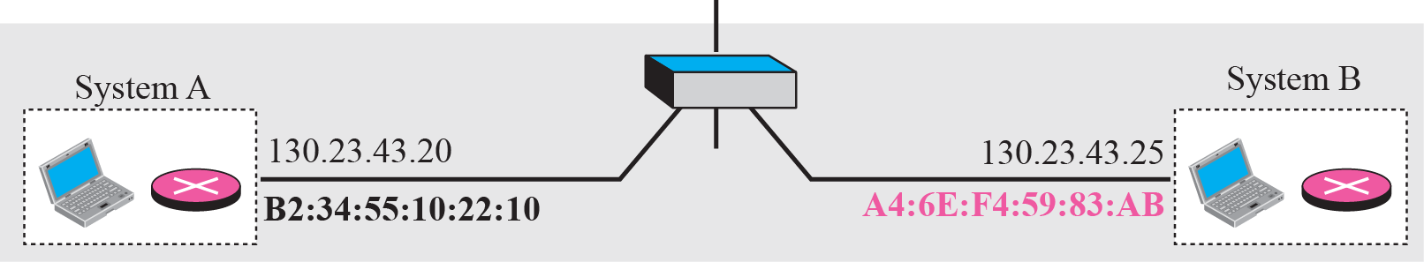
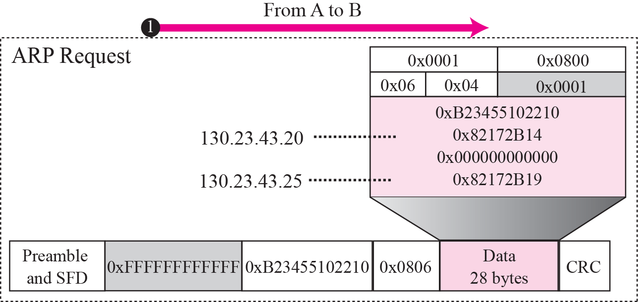
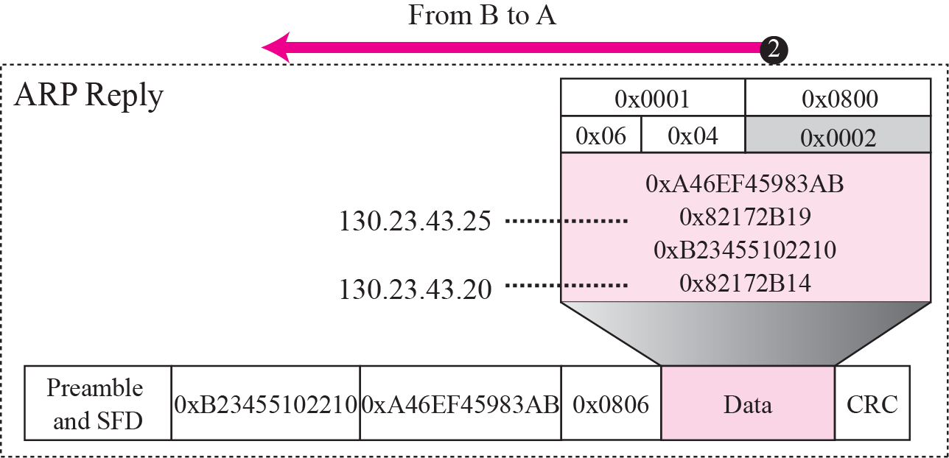
Figure 8.6 Example 8.1
IP addresses are shown in hexadecimal.
TCP/IP Protocol Suite

Slide 24
Figure 8.7 Proxy ARP
Proxy ARP
A technique called proxy ARP is used to create a subnetting effect.
A proxy ARP is an ARP that acts on behalf of a set of hosts.
Whenever a router running a proxy ARP receives an ARP request looking for the IP address of one of these hosts, the router sends an ARP reply announcing its own hardware (physical) address.
After the router receives the actual IP packet, it sends the packet to the appropriate host or router.
TCP/IP Protocol Suite

Slide 25
Figure 8.7 Proxy ARP
Proxy ARP
When it receives an ARP request with a target IP address that matches the address of one of its protégés (141.23.56.21, 141.23.56.22, and 141.23.56.23), it sends an ARP reply and announces its hardware address as the target hardware address.
When the router receives the IP packet, it sends the packet to the appropriate host.
TCP/IP Protocol Suite

Slide 26
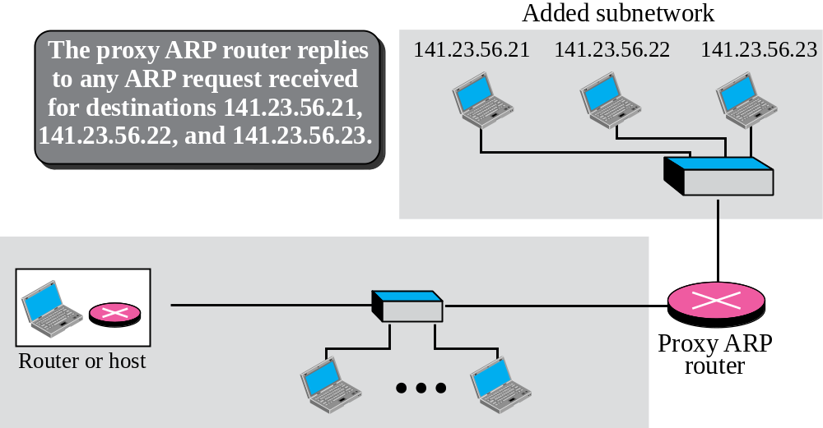
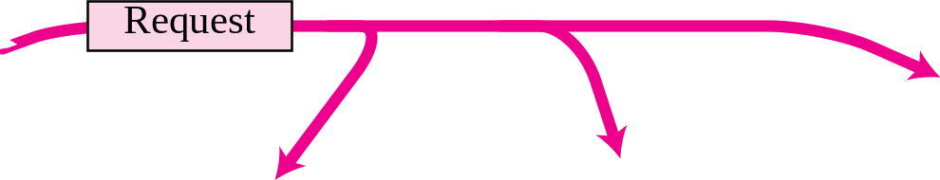
Figure 8.7 Proxy ARP
Let us give an example. In Figure 8.7 the ARP installed on the right-hand host will answer only to an ARP request with a target IP address of 141.23.56.23.
TCP/IP Protocol Suite

Slide 27
END
TCP/IP Protocol Suite

Slide 28
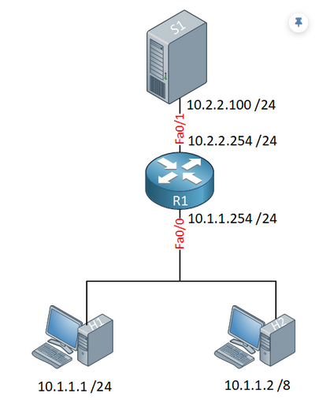
TCP/IP Protocol Suite

Slide 29
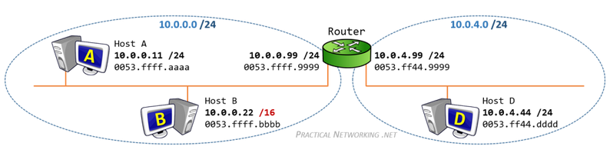
TCP/IP Protocol Suite

